Slide 1
Linear Programming
Dr. MD Sarder
Notes:
In this class we will learn how to solve LP problems using graphical method. You will find at least one question in the final from this chapter!

Slide 2
LP Formulation
Steps Involved:
  Determine the objective of the problem and describe it by a criterion function in terms of the decision variables.
  Find out the constraints.
  Do the analysis which should lead to the selection of values for the decision variables that optimize the criterion function while satisfying all the constraints imposed on the problem.
Notes:
LP formulation is a pre task to solve LP problems. You need to structure a problem. Steps involved are
Determine what you are trying to solve (e.g. are you finding minimum cost or maximum profit?)
What are the barriers/ obstacles to achieve your objectives?
Write equations and solve using any LP tool

Slide 3
LP Formulation
The Marriott Tub Company manufactures two lines of bathtubs, called Model A and model B. Every tub requires a certain amount of steel and zinc; the company has available a total of 25000 pounds of steel and 6000 pounds of zinc. Each model A bathtub requires a total of 125 pounds of steel and 200 pounds of zinc, and each yields a profit of $90. Each model B bathtub can be sold for a profit of $70; it in turn requires 100 pounds of steel and 30 pounds of zinc. Find the best production mix of the bathtubs.
Objective function (Maximize)
Constraints or subject to
Where x and y are the numbers of model A and model B bathtubs that the company will make, respectively.
Notes:
This is an example of LP problem. Read the problem statement – you will find that objective of this problem. The objective is find the best production mix – which translates that what products do Marriott Tub Company need to produce in what quantity to maximize its profit.
If the company produces x number of model A and y number of model B, the profit will be P =90x + 70y.
Two barriers/constraints are the limited resources - the company has available a total of 25000 pounds of steel and 6000 pounds of zinc. If the company produces x number of model A and y number of model B, total steel requirements will be 125x +100y which must be less than or equal to 25000 lbs of available steel. Similarly, total zinc requirements will be 20x +30y which must be less than or equal to 6000 lbs of available steel. The company also can not make negative amount of products at all – which means that x or y must be greater than or equal to zero.

Slide 4
Solving LP Problems
Graphical Method
Simplex Method
Excel Solver
Notes:
These are three widely used methods of solving LP problems. We will cover all three methods!

Slide 5
Graphical Method
The graphical method for solving linear programming problems in two unknowns is as follows.
A. Graph the feasible region.
B. Compute the coordinates of the corner points.
C. Substitute the coordinates of the corner points into the objective function to see which gives the optimal value OR draw the objective function line (equating to zero) and slide to the single extreme point of the feasible region!
Notes:
These are the steps of Graphical method. We will solve one sample problem to demonstrate this method.

Slide 6
Graphical Method
To sketch the region represented by a linear inequality in two variables:
A. Sketch the straight line obtained by replacing the inequality with an equality.
B. Choose a test point not on the line (0,0) is a good choice if the line does not pass through the origin, and if the line does pass through the origin a point on one of the axes would be a good choice).
C. If the test point satisfies the inequality, then the set of solutions is the entire region on the same side of the line as the test point. Otherwise, it is the region on the other side of the line. In either case, shade out the side that does not contain the solutions, leaving the solution region showing.
Notes:
This slide explains how to sketch regions represented by the constraint functions (equations). Graphical method is suitable for two variables problem. If you need to find more than two variables this method is complicated and hence can not be used. To completely understand how to use graphical method, you need to see the recorded lecture!

Slide 7
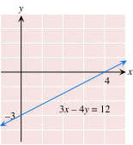
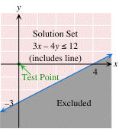
Graphical Method
To sketch the linear inequality: e.g. 3x - 4y ≤ 12,
first sketch the line 3x - 4y = 12.
Next, choose the origin (0, 0) as the test point (since it is not on the line). Substituting x=0, y=0 in the inequality gives 3(0) - 4(0) ≤ 12.
Since this is a true statement, (0, 0) is in the solution set, so the solution set consists of all points on the same side as (0, 0). This region is left un-shaded, while the (grey) shaded
region is blocked out.
Notes:
This slide explains how to draw lines and regions represented by constraint equations. You must have learned how to draw a line in your college algebra class – just refresh it. Once you are done with drawing lines, test your constraint equation with (0,0) point if that equation do not pass (0,0) point or with any other test point such as (1,0) or (0,3) etc. If the test point satisfies the constraint equation, exclude (shaded) regions on the other side of the line (opposite to the test point side). If the test point does not satisfy the constraint equation, exclude (shaded) regions on the same side of the line (test point side).

Slide 8
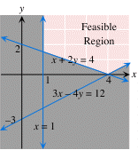
Feasible Region
The feasible region determined by a collection of linear inequalities is the collection of points that satisfy all of the inequalities.
To sketch the feasible region determined by a collection of linear inequalities in two variables: Sketch the regions represented by each inequality on the same graph, remembering to shade the parts of the plane that you do not want. What is un-shaded when you are done is the feasible region.
Example The feasible region for the following collection of inequalities is the un-shaded region shown below (including its boundary).
3x - 4y ≤ 12,
x + 2y ≥ 4
x ≥ 1
y ≥ 0.
Notes:
In OR, feasible region represents a set of solution space that is satisfied by all of the constraints. Any point within the feasible region can be a solution of that LP problem.
To sketch the feasible region, you need to draw each constraints and shade regions which is not part of solution space – see previous slide!
Following is an example problem where un-shaded region is feasible region. The solution of this problem could be any point within that feasible region!
You can use opposite convention as well where you will be shading feasible region only and leave all other region un-shaded!

Slide 9
Graphical Method
Product Mix Problem:
A Small beverage company produces Soda A and Soda B.
  Production limited by scarce resources: corn, hops, barley malt.
  Recipes for Soda A and Soda B require different proportions of ingredients.
How can this company maximize profits?
Beverage
Corn
(pounds)
Hops
(ounces)
Malt
(pounds)
Profit
($)
Soda A
5
4
35
13
Soda B
15
4
20
23
Available Quantity
480
160
1190
Notes:
A product mix problem is explained in this slide. This company can produce two beverages such as Soda A and Soda B but it has only 480 lbs of Corn, 160 lbs of Hops, and 1190 lbs of Malt. How much of what beverages should this company make to maximize its profit? Necessary information is given in the above table.

Slide 10
Graphical Method: Product Mix Problem
Problem Formulation:
Notes:
Suppose this company should make x quantity of Soda A and y quantity of Soda B to maximize its profit. Objective function will look like; Profit (P) = 13x + 23y, where $13 profit for each Soda A and $23 profit for each Soda B the company produces. Constraints equations will look like as above. For example each Soda A and Soda B will need 5 lbs and 15 lbs of Corn respectively. If this company produces x quantity of Soda A and y quantity of Soda B – the total amount of corn needed will be 5x + 15y which must be less than or equal to 480 lbs of corn available for this company. Neither x nor y can be a negative number – since company can not produce negative quantity of products (non-negative constraints).

Slide 11
Graphical Method: Product Mix Problem
Hops – (2)
4x + 4y ≤ 160
Malt – (3)
35x + 20y ≤ 1190
(0, 32)
(12, 28)
Corn – (1)
5x + 15y ≤ 480
(26, 14)
Soda B
(0, 0)
Soda A
(34, 0)
Notes:
Draw all constraints equations including non-negative constraints ( see previous slides to draw these lines). The region colored pink is the feasible region. Calculate coordinates for all intersection points (refresh your knowledge of college algebra). For example, solve equation 1 and x=0 (y axis) to find their intersection coordinates (0, 32), etc.

Slide 12
Graphical Method: Product Mix Problem
Corner Points | Value of Obj. f(n)
(0,0) | $0
(34,0) | $442
(26,14) | $660
(12,28) | $800
(0,32) | $736
(0, 32)
(12, 28)
(26, 14)
Soda B
(0, 0)
Soda A
(34, 0)
Notes:
Now put all intersection (corner points) coordinates value in the objective function equation and select the one that has maximum profit. In the above table, corner point (12, 28) gives the maximum profit of $800. Therefore this company should produce 12 Soda A and 28 Soda B.

Slide 13
Graphical Method: Product Mix Problem
(12, 28)
Profit
Soda B
13x + 23y = 800
Soda A
13x + 23y = 442
13x + 23y = 0
Notes:
Another way of solving this problem is as follows; you draw all constraints equations as well as objective function equation. Slide the objective function equation until it touches one extreme point of the feasible region and calculate coordinates for that point only. Substitute that coordinates value in the objective function equation to find the maximum profit.

Slide 14
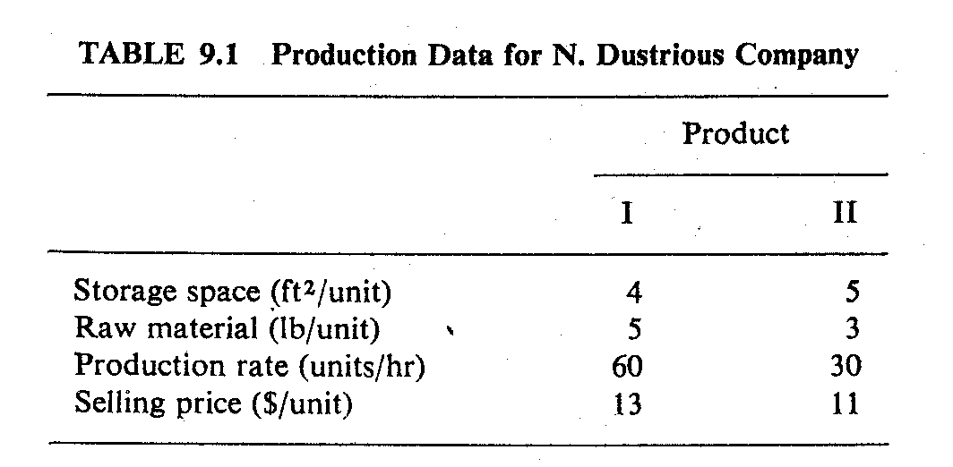
Graphical Method: Exercise Problem
The N. Dustrious Company produces two products: I and II. The raw material requirements, space needed for storage, production rates, and selling prices for these products are given in Table 1.
The total amount of raw material available per day for both products is 15751b. The total storage space for all products is 1500 ft², and a maximum of 7 hours per day can be used for production.
Notes:
This is an exercise problem for all of you. Formulate this problem and solve using graphical method.

Slide 15
Graphical Method: Exercise Problem
All products manufactured are shipped out of the storage area at the end of the day. Therefore, the two products must share the total raw material, storage space, and production time. The company wants to determine how many units of each product to produce per day to maximize its total income.
Formulate this problem and solve using graphical method.
Notes:
Here are some additional problem data that you will need to solve this problem.

Slide 16
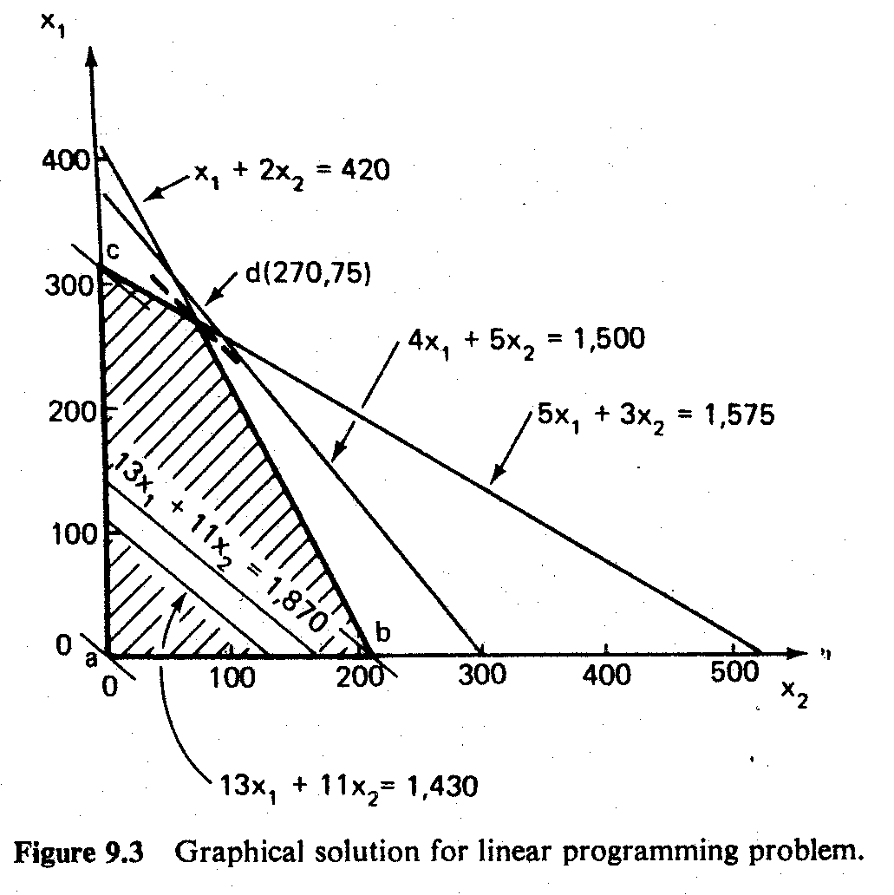
Graphical Method: Exercise Problem
Notes:
For your verification purpose, I provided the solution to you. You solve the whole problem and check your answer with this graph!

